Slide 1
The Moneyball of Music
Optimizing A&R Investment Strategies via Audio Feature Analysis
Ofri Kuperberg
Technical Presentation

Slide 2
The Dataset
15,000 songs
18 columns overall
Metadata columns (name, etc.)
Audio features columns:
Energy (0.0–1.0): Perceptual intensity (fast/loud/noisy) based on dynamic range and timbre.
Example: Bach (Low) vs. Death Metal (High).
Loudness (-6–0 dB): The overall loudness of a track in decibels (dB)
Valence (0.0-1.0): A measure from 0.0 to 1.0 describing the musical positiveness conveyed by a track.
Tracks with high valence sound more positive (e.g., happy, cheerful, euphoric), while tracks with low valence sound more negative (e.g., sad, depressed, angry).
Instrumentalness (0.0 – 1.0): Likelihood of no vocals (Values > 0.5 are instrumental).

Slide 3
Data Pipeline
Filtering:
  Focused on the modern era (2000s–Present) to ensure investment relevance (trends change).
  Removed duplicated songs (same song and artist name)
EDA:
  Class Imbalance:
    Hit songs: 1023
    Non-hit songs : 2346
  Artist diversity: high
    610 artists, mean 5.52, median 6
    only 22.95% have >8 songs.
    low risk of artist-driven bias
  Outliers:
    Some audio features have many outliers
    Some have none or close to none
    We use random forest model, and these outliers have meaning so we keep them

Slide 4
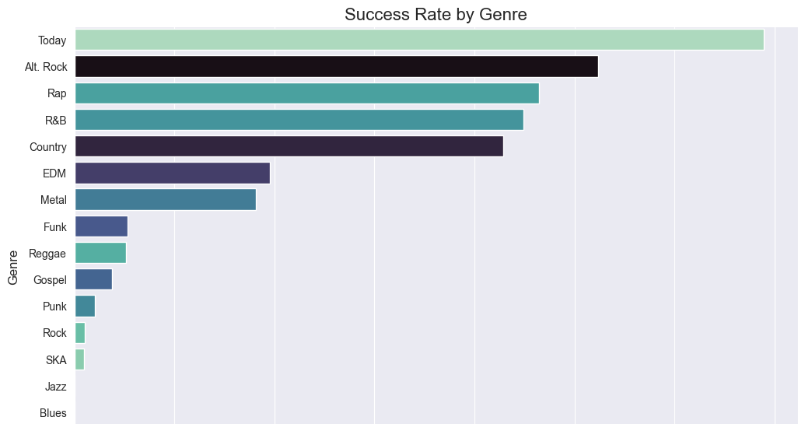

Slide 5
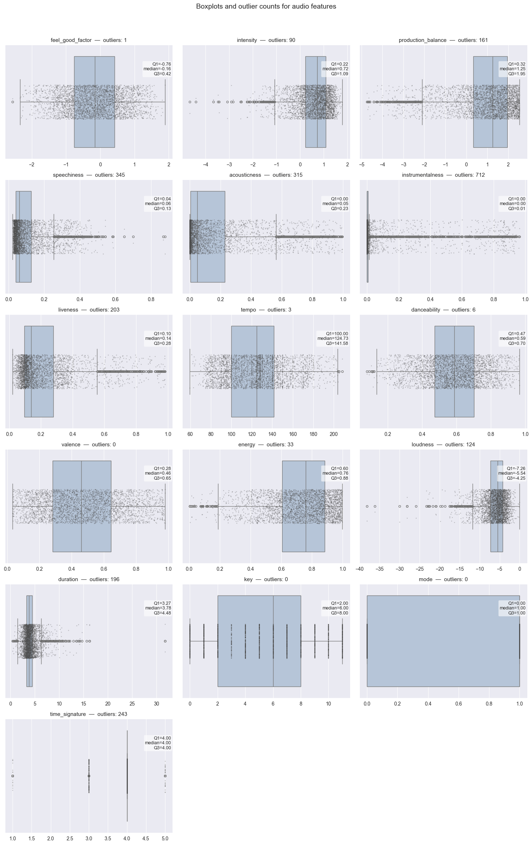
Audio features distribution

Slide 6
Feature Engineering
We engineered features to capture relationships between audio features
  Intensity (Energy + Loudness):
    The "Radio Ready" factor.
  Feel_Good_Factor (Valence + Danceability):
    Viral/TikTok potential.
  Production_Balance:
    Distinguishing acoustic niche tracks from produced pop hits.

Slide 7
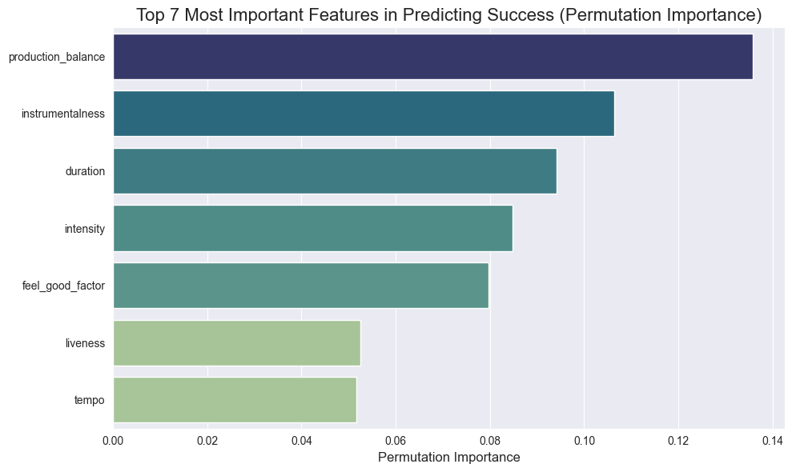

Slide 8
Model Strategy & Selection
Algorithm:
Random Forest Classifier.
Why?
Handles outliers well
Isn’t effected by multicollinearity
Handles Mixed feature type & Nonlinear relationships
Built-in OOB error estimation

Slide 9
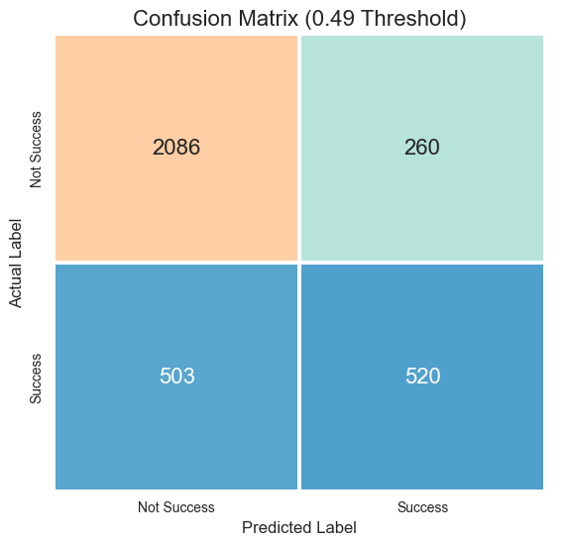
Results & Interpretation
Accuracy: ~78% (Overall).
Precision (Success Class): 67%.
Recall (Success Class): 51%

Slide 10
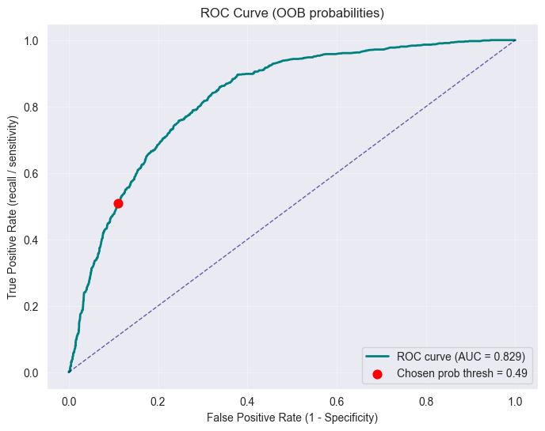
ROC & AUC

